Slide 1
Spatial Weight Matrix
Capture the adjacency/neighboring relationship between pairs of geometry
Categorization
Contiguity: share boundary lines/corner points
Rook, Queen, …
Distance: geodesic distance
Threshold Distance, K Nearest Neighbors, Inverse Distance, …

Slide 2
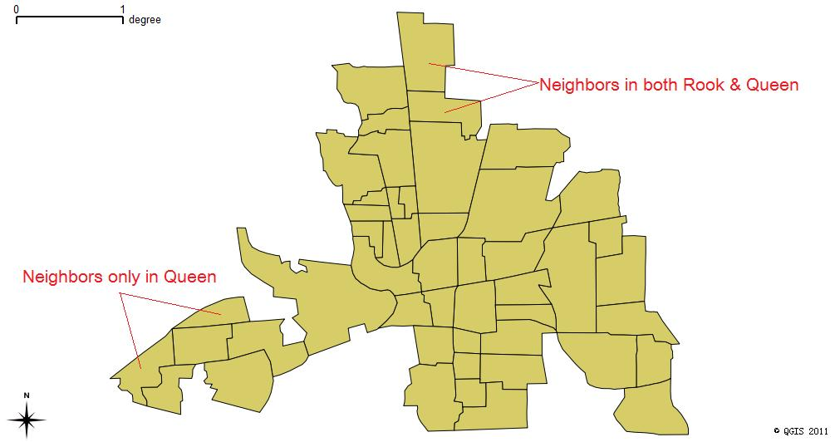
Rook/Queen

Slide 3
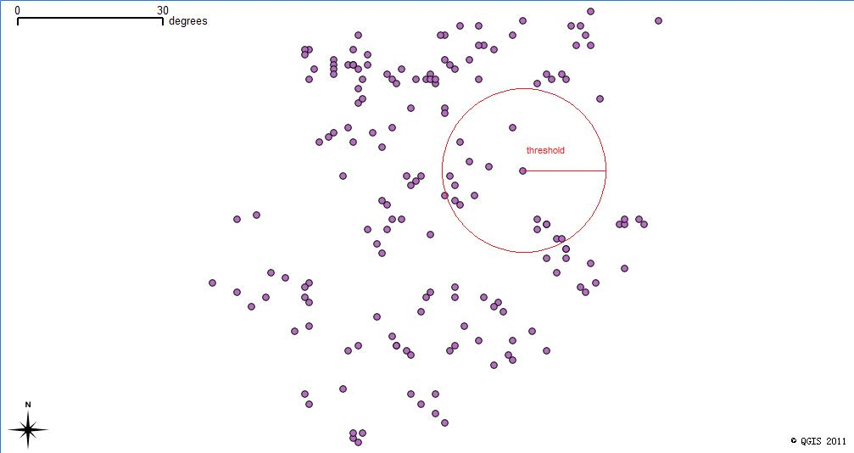
Threshold Distance

Slide 4
K Nearest Neighbors
The first K nearest elements as neighbors
Leave out all the rest

